Slide 1
Azure: Basics & Tips
Santosh Hari

Slide 2
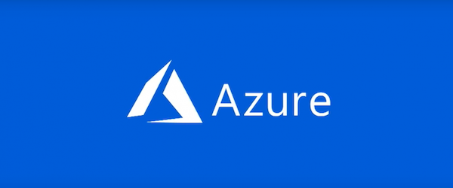
What is Azure?
Notes:
complete cloud platform
Host existing applications
Streamline development of new applications
enhance on-premises applications
Integrates cloud services to develop, test, deploy, and manage your applications

Slide 3
Why Azure?
Start small and scale
Reliable
Easy to manage
Portal
Programmability
Notes:
start small and easily scale your application as your customer demand grows
offers the reliability that’s needed for high-availability applications, even including failover between different regions
Azure portal lets you easily manage all your Azure services
manage your services programmatically by using service-specific APIs and templates

Slide 4
How do I start
Host – IaaS, PaaS, Serverless
Storage – Data, files
Auth
Dev and Monitoring
DevOps
Notes:
First, decide on how to host your application in Azure.
manage your entire infrastructure as a virtual machine
use the platform management facilities
serverless framework to host code execution only
application needs cloud storage
Take advantage of Azure's enterprise authentication.
tools for cloud-based development and monitoring,
most hosting services offer DevOps integration.

Slide 5
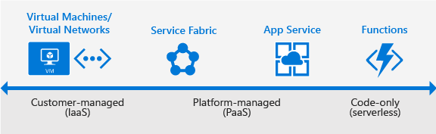
Hosting
Notes:
Azure offers services that support your application development and hosting needs.
Azure provides Infrastructure as a Service (IaaS) to give you full control over your application hosting.
Azure's Platform as a Service (PaaS) offerings provide the fully managed services needed to power your apps.
There is even true serverless hosting in Azure where all you need to do is write your code.

Slide 6
Azure App Service
Notes:
Quickest path to publish your web-based projects
makes it easy to extend your web apps to support your mobile clients and REST APIs
provides authentication by using social providers,
traffic-based autoscaling,
testing in production
continuous and container-based deployments.
create web apps, mobile app back ends, and API apps
all three app types share the App Service runtime

Slide 7
Azure App Service
Notes:
designed with DevOps in mind.
supports various tools for publishing and CI,
GitHub, Jenkins, Visual Studio Team Services, TeamCity, and others
can migrate your existing applications by using the online migration tool
When to use:
Use when you’re migrating existing web applications to Azure,
And need a fully managed hosting platform for your web apps.
Use when you need to support mobile clients
or expose REST APIs with your app.

Slide 8
Virtual Machines
Notes:
(IaaS) provider
deploy to or migrate your application to either Windows or Linux VMs.
Together with Virtual Network, VM supports of Windows or Linux
total control over the configuration of the machine.
responsible for server software, configuration, maintenance, and OS patches
level of control HIGH
can run a wide range of server workloads on Azure that don’t fit into a PaaS model.
workloads include database servers, Active Directory, and Microsoft SharePoint.

Slide 9
Virtual Machines
Notes:
When to use:
when you want full control over your application infrastructure
or to migrate on-premises workloads to Azure without changes.

Slide 10
Azure Functions
Notes:
Rather than worrying about building out and managing a whole application or the infrastructure to run your code.
What if you could just write your code and have it run in response to events or on a schedule?
"serverless” lets you write just the code you need.
code execution triggered by HTTP requests, webhooks, cloud service events, or on a schedule.
code in development language of choice, such as C#, F#, Node.js, Python, or PHP.
With consumption-based billing, pay only for time code executes, and Azure scales as needed.

Slide 11
Azure Functions
Notes:
When to use:
Use when you have code that is triggered by other services, by events, or on a schedule.
when you don't need the overhead of a complete hosted project
or when you only want to pay for the time that your code runs.

Slide 12
Service Fabric
Notes:
distributed systems platform
makes it easy to build, package, deploy, and manage scalable and reliable microservices
provides comprehensive application management capabilities
for provisioning, deploying, monitoring, upgrading/patching, and deleting deployed applications
Apps, run on a shared pool of machines,
can start small and scale to hundreds or thousands of machines as needed.
Service Fabric supports WebAPI with Open Web Interface for .NET (OWIN) and ASP.NET Core.
Provides SDKs for building services on Linux in both .NET Core and Java.

Slide 13
Service Fabric
Notes:
When to use:
good choice when you’re creating
or rewriting an existing application to use a microservice architecture.
when you need more control over, or direct access to, the underlying infrastructure.

Slide 14
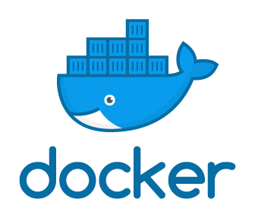
Docker support
Notes:
OS virtualization, let you deploy applications in a more efficient and predictable way
containerized app works in prod the same way as on your dev and test
Manage with standard Docker tools
can use your existing skills and popular open-source tools

Slide 15
Docker support
Azure Docker VM extension
Azure Container Service
Docker Machine
Custom Docker image for App Service
Notes:
Azure Docker VM extension:
Configure VM with Docker tools to act as a Docker host. When to use:
to generate consistent container deployments for your apps on a VM, or when you want to use Docker Compose.
Azure Container Service:
create, configure, and manage a cluster of virtual machines preconfigured to run containerized applications.
When to use:
When you need to build production-ready, scalable environments, or when you’re deploying a Docker Swarm cluster.
Docker Machine:
install and manage a Docker Engine on virtual hosts by using docker-machine commands. When to use:
When you need to quickly prototype an app by creating a single Docker host.
Custom Docker image for App Service:
use Docker containers from a container registry or a customer container when you deploy a web app on Linux. When to use:
When deploying a web app on Linux to a Docker image.

Slide 16
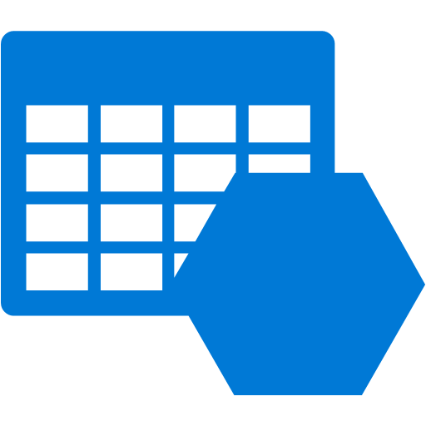
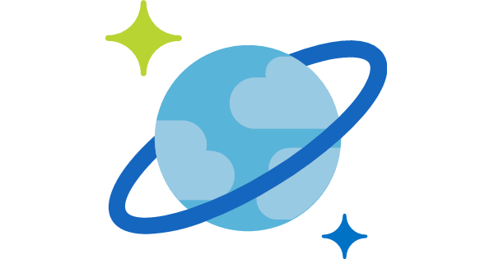
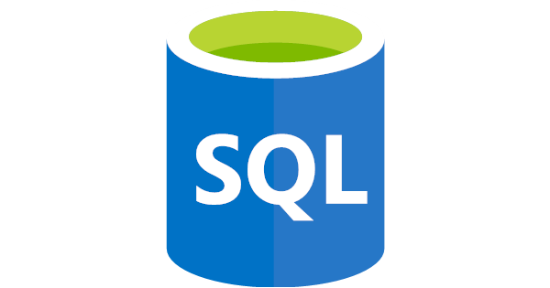
Hosted Storage and Data Access
Azure CosmosDB
Azure Storage
Azure SQL Database
Notes:
Most applications must store data,
so regardless of how you decide to host your application in Azure,
consider one or more of the following storage and data services.

Slide 17
SQL Server
Azure CosmosDB
Azure Storage
Azure SQL Database
Notes:
Azure SQL Database:
Azure-based version of Microsoft SQL Server engine
storing relational tabular data in the cloud.
provides predictable performance, scalability with no downtime, business continuity, and data protection. When to use:
When application requires data storage with referential integrity, transactional support, and support for TSQL queries.

Slide 18
CosmosDB
Azure CosmosDB
Azure Storage
Azure SQL Database
Notes:
Azure Cosmos DB:
globally distributed, multi-model database service
enables you to elastically scale throughput and storage
across any number of geographical regions with a comprehensive SLA. When to use:
When application needs document, table, or graph databases,
including MongoDB databases,
with multiple well-defined consistency models.

Slide 19
Azure Storage
Azure CosmosDB
Azure Storage
Azure SQL Database
Notes:
Azure Storage:
Offers durable, highly available storage
blobs, queues, files, and other kinds of nonrelational data.
Storage provides the storage foundation for VMs, App Service and Functions
When to use:
When your app stores nonrelational data,
key-value pairs (tables), blobs, files shares, or messages (queues).

Slide 20
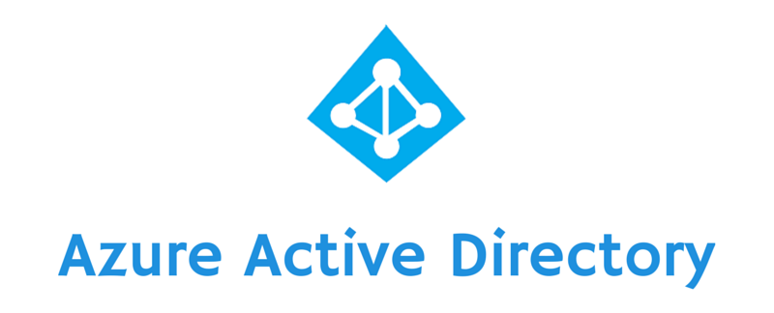





Authentication
Notes:
It's crucial to not only know who is using your applications,
but also to prevent unauthorized access to your resources.
Azure provides several ways to authenticate your app clients.

Slide 21
Azure AD
Notes:
Microsoft multitenant, cloud-based identity and access management service.
Add single-sign on (SSO) to your applications by integrating with Azure AD.
Uses Azure AD Graph API directly or the Microsoft Graph API.
integrate with Azure AD support for the OAuth2.0 authorization framework and Open ID Connect by
using native HTTP/REST endpoints and the multiplatform Azure AD authentication libraries. When to use:
When you want to provide an SSO experience, work with Graph-based data, or authenticate domain-based users

Slide 22
App Service Auth
Notes:
When you choose App Service to host your app,
you also get built-in authentication support for Azure AD,
along with social identity providers—including Facebook, Google, Microsoft, and Twitter. When to use:
When you want to enable authentication in an App Service app by using Azure AD, social identity providers, or both.

Slide 23
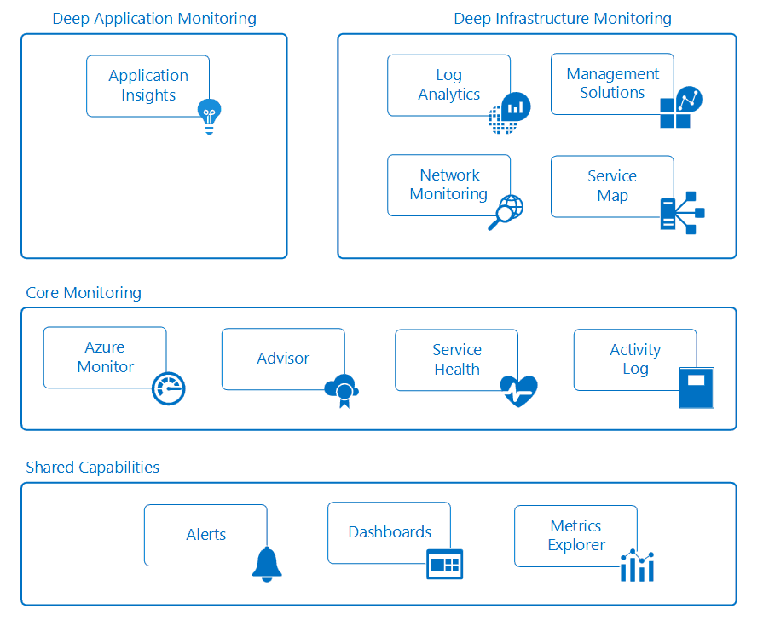
Monitor Performance
Notes:
Visual Studio Application Insights:
Azure-hosted extensible analytics service
integrates with Visual Studio to monitor your live web applications.
gives you the data need to continuously improve the performance and usability of your apps,
whether they’re hosted on Azure or not
Azure Monitor:
Service to visualize, query, route, archive, and act on the metrics and logs
that are generated by your Azure infrastructure and resources.
Monitor provides the data views that you see in the Azure portal
single source for monitoring Azure resources

Slide 24
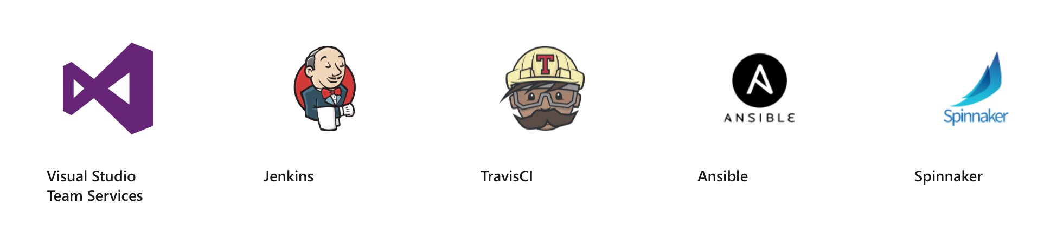
Devops Integration
Notes:
provisioning VMs or publishing your web apps with continuous integration,
Azure integrates with most of the popular DevOps tools.
Jenkins, GitHub, Puppet, Chef, TeamCity, Ansible, VSTS,
you can work with the tools that you already have and maximize your existing experience.

Slide 25
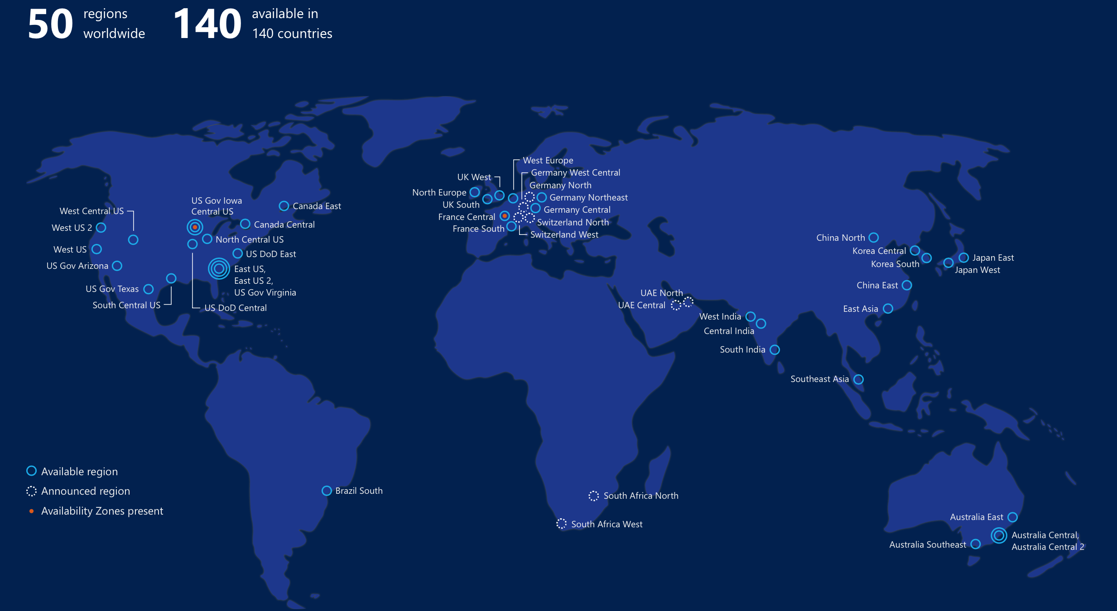
Azure regions
Notes:
global cloud platform 50 regions serving 140 countries
generally available in many regions around the world.
When you provision a service, application, or VM in Azure,
you are asked to select a region,
represents a specific datacenter where application runs or data is stored.
These regions correspond to specific locations
To make your app more resilient replicate across datacenters

Slide 26
Management Tools
Portal
CLI
Powershell
REST APIs

Slide 27
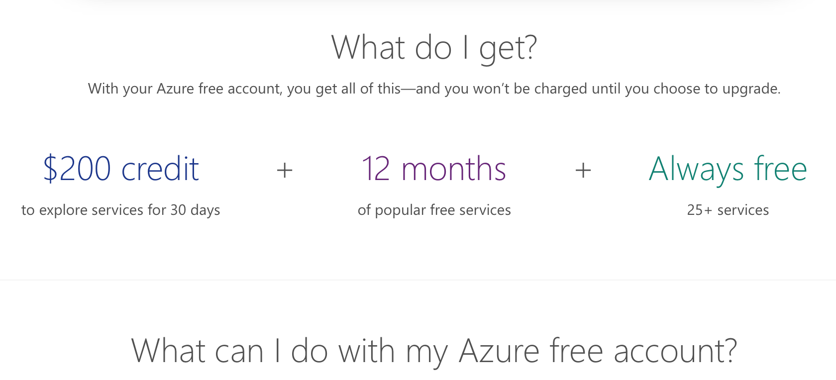
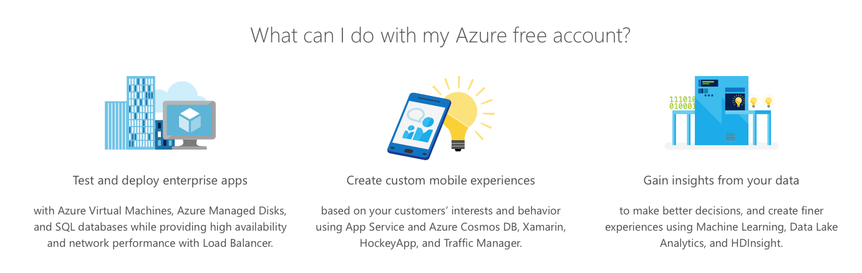
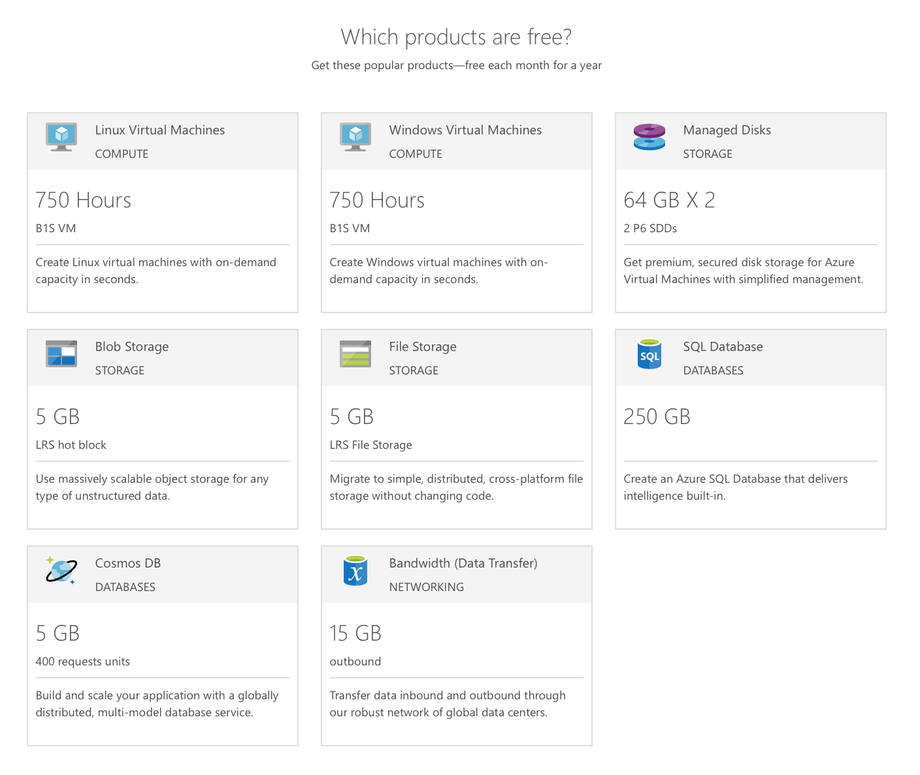
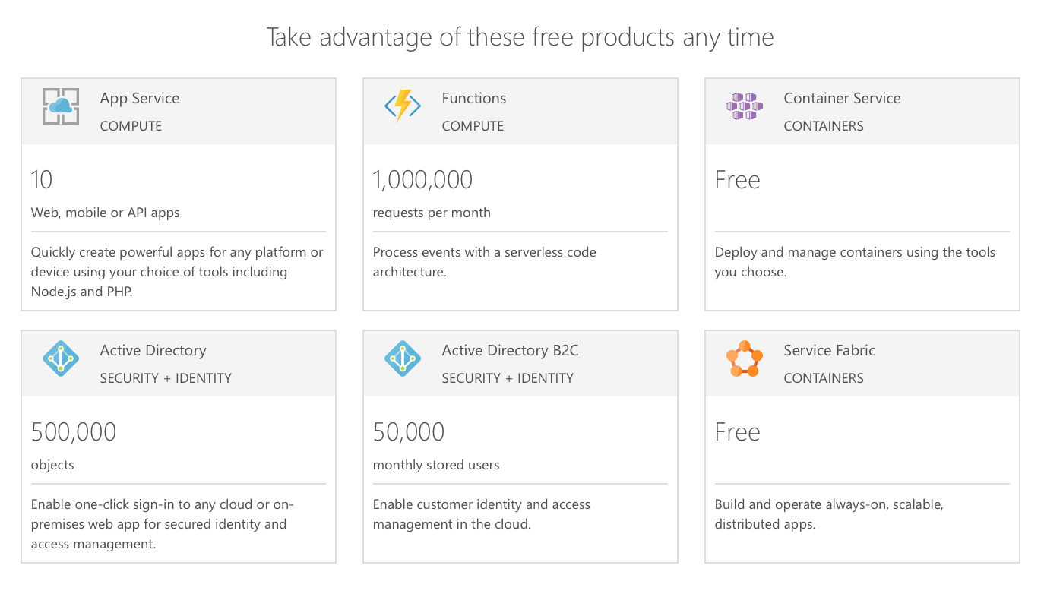
Get started right away – Free Azure
https://azure.microsoft.com/en-us/free/

Slide 28


CLOUD
$25K of free Azure Cloud credits for one year and up to $120K of additional credits in the second year
The Microsoft for Startups program
DEVELOPMENT
Visual Studio Enterprise Cloud Monthly Subscription
Specific program benefits
PRODUCTIVITY
Office 365 Business Premium
TECHNICAL SUPPORT
Microsoft Azure Standard Support Plan, including unlimited 24x7 technical support
*Dynamics 365 and co-sell benefits available for qualified startups
DYNAMICS 365*
Dynamics 365 for Sales (CRM) & Dynamics 365 for Talent (benefits available for qualified startups)
DYNAMICS 365 TECH SERVICES*
Dynamics 365 Pro Direct
(benefits available for qualified startups)
STARTUP CO-SELL*
New dedicated resources help sell to enterprise customers (benefits available for qualified startups)
Notes:
Previously Bizspark
helping startups become viable partners in the enterprise ecosystem through our direct salesforce and worldwide channel
Giving them access to worldwide partner benefits (e.g. business and technical resources, co-selling and co-marketing) while providing the incremental support necessary for startups to help them grow in today’s cloud economy (e.g. ScaleUp program, unique co-sell assets, technical community support)
Prioritizing B2B startups who have the greatest potential for market success by taking advantage of our commercial go-to-market (GTM) benefits
Extending startup engagement beyond relationship building in small scale to create a much larger community motion that drives Azure and Dynamics adoption
Using marketplace (Azure Marketplace and AppSource) as a startup’s launchpad for all GTM efforts (all promotion activities will point back to their artifact - solution or offer – published in our marketplace)
Aligning to the Microsoft Partner Network (MPN) and the broader partner motion across the Microsoft field organizations

